Slide 1

Which Defect Should Be Fixed First? Semantic Prioritization of Static Analysis Report
Han Wang, Min Zhou, Xi Cheng, Guang Chen, Ming Gu
Tsinghua University, Beijing, China
Notes:
on behalf of Wang Han.

Slide 2
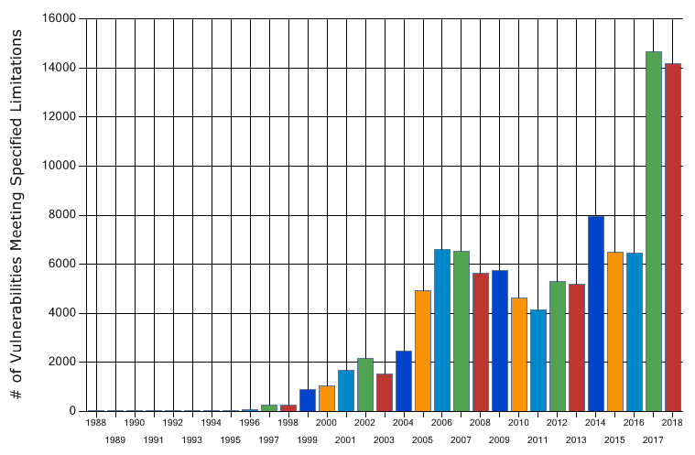








Background
No defect-free complicated programs
Drives the birth of defect detection tools
Static analysis
Dynamic analysis
gives too much defect report
Statistics on vulnerability based on year
Notes:
As the scale of open and close source software system grows, the number of defects in them grows, too. the iteration of the new version of the software will bring in many new defects.
Developers use static analysis and dynamic analysis to guarantee code quality, but both analyzers give too much defect reports. Meanwhile, large number of defect reports are received in bug tracking systems.
According to the statistics from NVD website, The total number of defects has exceeded 120,000. And in the last two years, the number of vulnerabilities has been increasing significantly.

Slide 3




Defect management
Bugzilla: a server software designed to help you manage software development
Products: Mozilla, Eclipse
Defect status
Mozilla bug database
Over 500,000 defect report
170 defect received each day
Eclipse bug database
Over 250,000 defect report
120 defect received each day
Conclusion
Hard to fix all defects for a continuously updated software
Which defect should be fixed first?
Prioritize defects: set fix priority for defects
Notes:
Because there’s too many defects in all kinds of systems, especially in continuously build systems. Defects increase with the amount of code increase.
So it’s hard to fix all defects.
For example: As of August 2009, the Mozilla bug database contains over 500,000 and the Eclipse bug database over 250,000 bug reports. On average, Mozilla received 170 and Eclipse 120 new bug reports on each day from January to July 2009.
Developers could not fix all defects in their programs, a sensible way is to fix the defects that need to be fixed urgently and leave defects with low priority unfixed.
defect prioritization is a way to set fix priority for defects, so developers can fix defects just according to their priority or severity order.

Slide 4
Existing defect prioritization approaches
Industry:
Bug triage: assign severity of defects manually
Academia:
Statistical based approaches
Use powerful statistical model to represent the properties of defects
Machine learning based approaches
Use a large amount of labeled data to fit machine learning models
require large workload
large amount of labeled data
accuracy problem in large amount of defect
how to use proper features to represent a defect
Static Analysis: defects with high effect domain have high fix priority.
Notes:
To prioritize the defects, bug triage is widely used in industry. Developers discuss about defects and set severity and priority for them manually.
However, bug triage need to deal with these reports manually utilizes time and resources which leads to delaying the resolution of important bugs.
Some automatic approaches to prioritize defects has been proposed. These approaches can be divided into two categories.
Statistical based approaches use powerful statistical model to represent the properties of defects, which is very helpful in duplicate bug reorganization.
Machine learning based approaches use a large amount of labeled data to fit models, which gives high accuracy on specific data set. But those approaches need to extract proper features to represent defects, and needs large amount of labeled data. So those approaches did not get satisfactory accuracy in real life defects.
To avoid those problems, we hold that defects with high effect domain will have high fix priority, and use static analysis to analyze the effect domain of defects and prioritize them automatically.

Slide 5
Challenges for defect prioritization
How to find all affected paths of a defect?
How to balance inter-function analysis and intra-function analysis?
How to set priority for a defect?
Notes:
To sum it up, there are three challenges we need to face.

Slide 6

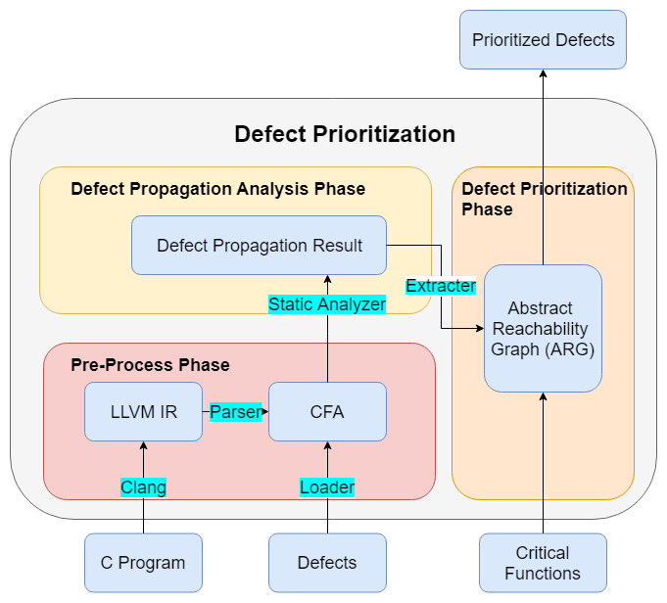
Framework
Notes:
Here is the framework of our approach.
The input of our approach is C program and it’s according defect list, and the output is prioritized defects list.
At first, we compile the C program into LLVM, then parse it into CFA, a structure which represents source code, which will be introduced later.
Then we extract critical functions from CFA, critical functions are memory related functions, such as malloc, free, etc.
Then we combine defects list, critical function set and CFA to use static analyzer to analyze the propagation of defects, then extract defect propagation result and calculate prioritized defects list according to their affect domain.

Slide 7
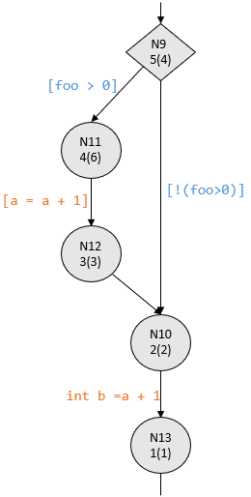
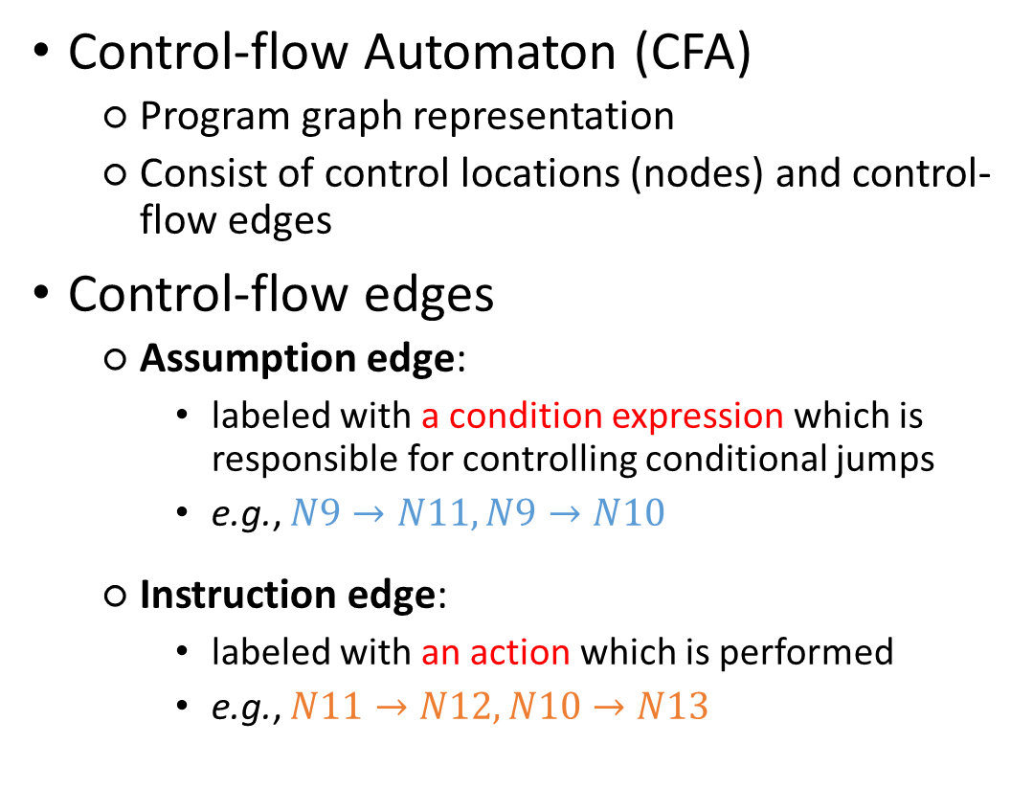
Pre-process Phase
Control-flow Automaton (CFA)
Program graph representation
Consist of control locations (nodes) and control-flow edges
Control-flow edges
Assumption edge:
labeled with a condition expression which is responsible for controlling conditional jumps
e.g., $N9→N11, N9→N10$
Instruction edge:
labeled with an action which is performed
e.g., $N11→N12, N10→N13$
if (foo > 0) {
a = a + 1;
}
int b = a + 1;
Notes:
CFA is short cut for control flow automation
CFA is a graph representation of program which consists of control locations and control-ﬂow edges. Control locations model the domain of program counter pc.
There are two kinds of edges in CFA, one is instruction edge, the other is assume edge.
Assume edge is labeled with a condition expression which is the guard condition for the edge to be taken.
On the other hand, instruction edge is labeled with an action that is performed when the edge is taken.
For example in the figure, edge N9 → N11 and edge N9 → N10 are assume edges, edge N11 → N12 and N10 → N13 are instruction edges.
Our static analysis algorithms rely upon traversal on CFA.

Slide 8
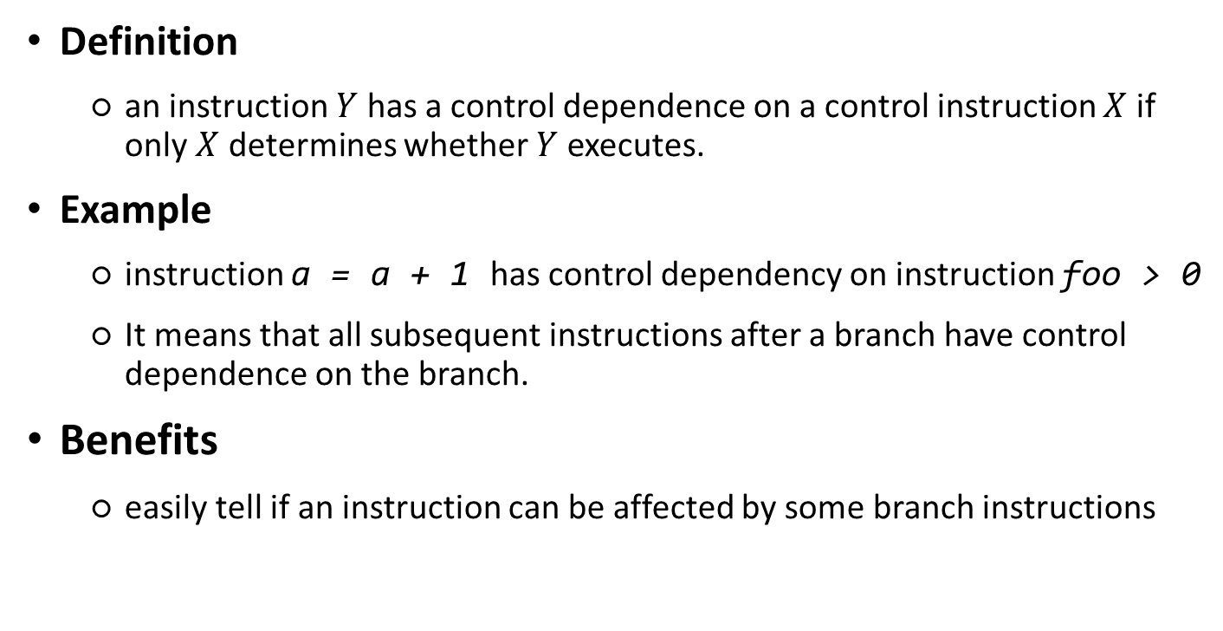
Pre-process phase(Control Dependency)
Definition
an instruction $Y$ has a control dependence on a control instruction $X$ if only $X$ determines whether $Y$ executes.
Example
instruction a = a + 1 has control dependency on instruction foo > 0
It means that all subsequent instructions after a branch have control dependence on the branch.
Benefits
easily tell if an instruction can be affected by some branch instructions
Notes:
An instruction Y has a control dependence on a
control instruction X if only X determines whether Y executes.
Consider the previous example in the figure, instruction a = a + 1 (edge N11 →
N12) has control dependence on instruction foo > 0 (edge N9 → N11). Basically,
if we have a branch, all subsequent instructions have control dependence on
the branch.
With the knowledge of control dependencies, we can easily tell if an instruction can be aﬀected by some branch instructions. But whether the subsequent instructions outside of the branches will be executed will not be determined by branch instructions. This information is very important for our following defect propagation algorithm.

Slide 9
Defect prioritization phase(critical function set)
Critical functions
perform critical operations such as memory allocation
have a large number of callers
can also be manually specified by the program analyst
Extraction strategies
All: naively take all functions as critical functions
Top-K: extract functions with a large number of callers
User-specified: experts recommendation functions with their knowledge of the subject program, e.g., memory operations related functions
Notes:
As we mentioned before,
There’s two kinds of analysis in static analysis: Inter-function analysis which provides better accuracy and intra-function analysis which provides better effectiveness.
Our approach need to balance between inter-function analysis and intra-function analysis.
So we came up with the idea of critical function set.
Critical functions are functions that :
perform critical operations such as memory allocation
have a large number of callers
can also be manually specified by the program analyst
In this work we use the following way to combine inter-function analysis and intra-function analysis: for widely used core library functions, we pre-train a fatality score to represent the severity of that function, we use that score to skip the analysis of that function
For user defined functions, we use inter-function analysis to analysze the propagation of defects in them.
There are strategies we used to extract critical functions:
The first one is: naively take all functions as critical functions
The second one is to extract functions with a large number of callers
The last one is experts recommendation functions with their knowledge of the subject program, e.g., memory operations related functions

Slide 10
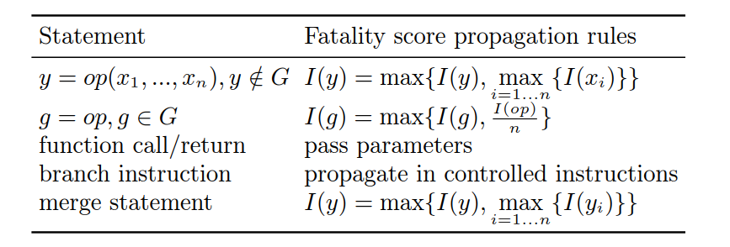
Defect propagation phase
We assign a initial fatality score for variables affected by defect directly.
Defect propagation via the propagation of the fatality score.
Notes:
We use variable value passing to represent the propagation of defects.
First of all, variables used by defected expressions are labeled as aﬀected. Then we assign those variables a score called fatality score and propagate the score during the analyzing process.
During the propagation, we pass the fatality score according the different statement.
For assignment, we simply pass the fatality score from right value to left value.
For function call/return, we pass score to pass parameters.
For branch instruction, we pass score to it’s controlled instructions.
For merge statement, we merge the fatality score from different node.

Slide 11
Defect propagation phase
When condition is propagated from a defect
(a, 1.0)
(b, 1.0)
Code block 1 is affected
if ( condition statement ) {
//code block 1
} else {
//code block 2
}
//code block 3
(b, 0.5)
(c, 0.5)
Code block 2 is also affected
(a, 1.0)
(b, 1.0)
(c, 0.5)
Propagation ends at code block 3 and variable-fatality score starts to be merged
Notes:
Here’s an example defect propagation in branch instruction and merge statement.
For example, if the condition statement in the above code list is propagated from a defect, whether instructions in code block 1 and 2 will be executed will be aﬀected. Since all instructions in code block 1 and 2 will be aﬀected by the defect in the condition statement, the propagation is diﬀerent from normal propagation. The defect will be propagated to all instructions in code block 1 and 2. This mode of propagation ends at code block 3 because not all instructions in code block 3 will be aﬀected by the defect.
After the analysis in code block 1 and 2, the result in them need to be merged in code block 3.
For example, if node 1 stores variable-fatality score map {(a, 1.0), (b, 0.5)}, node 2 stores {(b, 1.0), (c, 0.5)}, then their merging result is {(a, 1.0), (b, 1.0), (c, 0.5)}

Slide 12
Evaluation
Find defects
Scan-build: the static analyzer for Clang
Label defects
extract consecutive past release versions of a project.
run static analysis on those release versions of the project.
compare the bug report of those release versions of the project
label all defects which disappear in latest release version’s report as fixed defect. Other defects are labeled as unﬁxed defects.
Notes:
To evaluate our work, we Use clang’s static analyzer scan-build to find defects in open source programs.
Then we use the following way to label defects:
extract consecutive past release versions of a project.
run static analysis on those release versions of the project.
compare the bug report of those release versions of the project
label all defects which disappear in latest release version’s report as fixed defect. Other defects are labeled as unﬁxed defects.

Slide 13
Evaluation
Dataset: open source projects on Github
Nuklear: a single-header ANSI C GUI library.
MASSCAN: a TCP port scanner.
GoAccess: a real-time web log analyzer and interactive viewer.
Twemproxy: a fast, light-weight proxy for memcached and redis.
Project | Release | #Defects | #Fixed Defects
Nuklear | * | 8 | 3
 | * | 6 | 1
 | * | 10 | 0
 | * | 12 | 0
 | * | 12 | 0
MASSCAN | 1.0.1 | 9 | 4
 | 1.0.3 | 9 | 3
 | 1.0.5 | 8 | 0
GoAccess | 0.7 | 11 | 6
 | 0.8 | 10 | 5
 | 0.9 | 6 | 0
Twemproxy | 0.1.16 | 23 | 4
 | 0.1.20 | 23 | 3
 | 0.2.0 | 24 | 0
 | 0.3.0 | 25 | 0
Notes:
We applied this approach to diﬀerent releases of open-source projects from GitHub. and got the defect numbers and ﬁxed defect numbers shown in the Table.
– Nuklear is a single-header ANSI C GUI library. It does't have any release currently. But it has 1,549 commits currently, so we use scan-build analyzed
5 former commits. And found 3 ﬁxed defects out of 8 defects in commits.

Slide 14
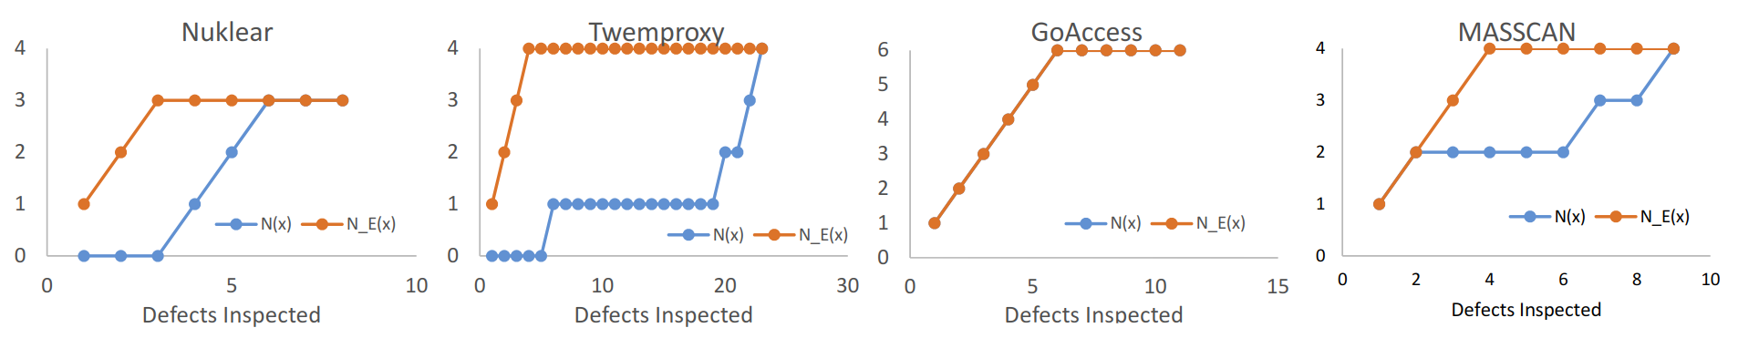
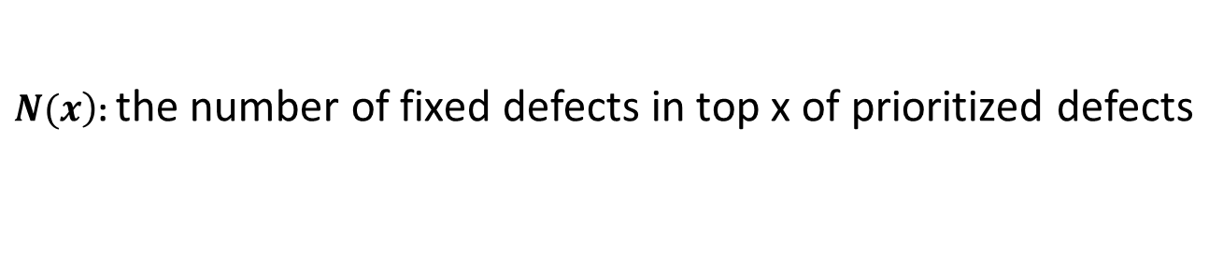
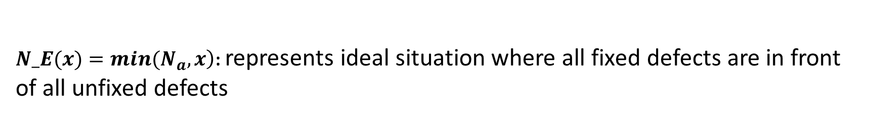
Accuracy Experiment
$\left.N(x\right)$: the number of fixed defects in top x of prioritized defects
$\left.N_E(x)=min(N_{a},x\right)$: represents ideal situation where all fixed defects are in front of all unfixed defects
Notes:
We evaluate the accuracy of our method by checking if we set ﬁxed defects’ priority higher than all unﬁxed defects.
(Na is the number of ﬁxed defects in all defects.)
So to evaluate the accuracy of our method, we just need to calculate the correlation coeﬃcient between N(x) and N_E(x). The closer correlation coeﬃcient to 1, the higher our accuracy.
The X-axis of the ﬁgure is top x defects. The Y-axis of the ﬁgure is ﬁxed defects among those
defects. The correlation coeﬃcient between N(x) and N E(x) for 4 projects are 0.61, 0.42, 1 and 0.65 respectively.

Slide 15
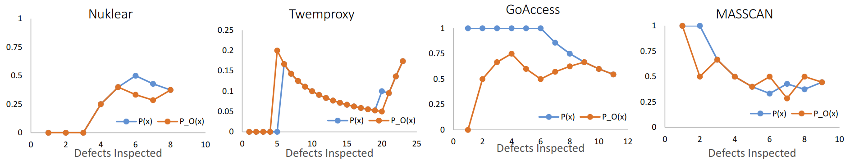
Prioritization Improvement Experiment
$P(x)=\frac{\left.N(x\right)}{x}$ denotes the rate of ﬁxed defects in top x of prioritized defects
$P_O(x)=\frac{\left.N_O(x\right)}{x}$ describes the rate of ﬁxed defects in top x of randomly ranked defects
Notes:
To evaluate the recall of our method, we check if the ﬁxed defects ranked high enough in our prioritized defects.
(where N_O(x) is the number of defects in top x of original defects.)
So to evaluate the recall of our method, we just compare the value of P(x) and P_O(x)
The X-axis of the ﬁgure is top x defects. The Y-axis of the ﬁgure is the rate of ﬁxed defects among those
defects. For most cases, P(x) are better than P_O(x).

Slide 16
A case of defect propagation
1 int G;
2 int foo() {
3 return G;
4 }
5 int bar() {
6 int a, b, c, d;
7 a = defect();
8 G = a;
9 if (a > 1) {
10 b = 1;
11 }
12 c = foo();
13 d = a + b + c;
14 }
foo
function start
Return G;
foo()
return from foo
bar
a = defect();
G = a;
a > 1
b = 1;
c = foo();
d = a + b + c;
!(a > 1)
Notes:
Here is an example of defect propagation,
The code above have a global variable G, two functions foo and bar.
the variable a in function bar has been affected by a defect in line 7.
By the value passing in line 8, the global variable G was affected by a..
Since a is affected, the branch condition in line 9 was affected, so the statement b = 1 in line 10 is affected, too. That means variable b is affected.
The function foo returns global variable G and G is affected, so variable c is affected in line 12.
In line 13, all right values a, b, c are affected, left value variable d is affected too.

Slide 17
Future work
1 table = (transition_t*)malloc(sizeof(transition_t*) * row_count * column_count);
2 \\ code block
3 memset(table, 0, sizeof(transition_t*) * row_count * column_count);
Balancing fatality score for critical functions is tricky.
Data mining could be a good way.
Combing with categorical attributes.
Notes:
Besides this, we dig into a failed case in our experiment, the code is from project MASSCAN.
The case is a memory leak defect, Programmer allocated wrong size of memory for pointer variable in line 1. Then they used the variable in function memory set, which could lead to severe memory error.
They ﬁxed the bug at version 1.0.5 by change the pointer variable in size of to a variable.
But this defect dose not have a large affection domain, so the defect’s rank is low in our experiment. The developers fixed it because it affected critical function memory set. This can be ﬁxed by specifying memory related functions as critical functions.
So our future work need to balance the fatality score for critical functions. Use data mining to assign fatality scores might be a good way.
On the other hand, combining the defect's affect domain and other categorical attributes could improve the accuracy.

Slide 18



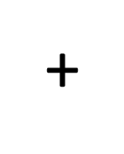


Conclusion
Original code
CFA
parse
Static analysis to analyze defect propagation
Use fatality score to skip unnecessary inter-function analysis
Fatality score for variables and CFA to represent defect propagation path
extract
Defects list
Critical Function Set
Defect propagation result
Prioritized defects list
Static analyzer
Extractor

Slide 19
Thank you
Feel free to email: h-wang16@mails.tsinghua.edu.cn

